Slide 1

ALGEBRA
Math 10-3

Slide 2
LESSON 3
RATIONAL EXPRESSIONS

Slide 3
RATIONAL EXPRESSIONS
A rational expression is a fraction in which the numerator and denominator are polynomials.
For example, the expressions below are rational expressions.
The domain of a rational expression is the set of all real numbers that can be used as replacements for the variable.

Slide 4
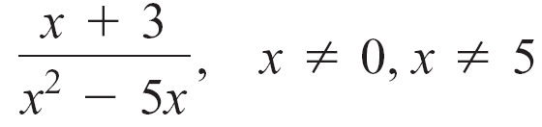
RATIONAL EXPRESSIONS
Any value of the variable that causes division by zero is excluded from the domain of the rational expression. For example, the domain of
is the set of all real numbers except 0 and 5.
Both 0 and 5 are excluded values because the denominator x² – 5x equals zero when x = 0 and also when x = 5.

Slide 5
RATIONAL EXPRESSIONS
Sometimes the excluded values are specified to the right of a rational expression, as shown here.
However, a rational expression is meaningful only for those real numbers that are not excluded values, regardless of whether the excluded values are specifically stated.

Slide 6

RATIONAL EXPRESSIONS
Rational expressions have properties similar to the properties of rational numbers.
Properties of Rational Expressions
For all rational expressions and , where Q ≠ 0 and S ≠ 0,
Equality if and only if PS = QR
Equivalent expressions
Sign

Slide 7
SIMPLIFYING RATIONAL EXPRESSIONS

Slide 8
SIMPLIFYING RATIONAL EXPRESSIONS
To simplify a rational expression, factor the numerator and denominator.
Then use the equivalent expressions property to eliminate factors common to both the numerator and the denominator.
A rational expression is simplified when 1 is the only common factor of both the numerator and the denominator.

Slide 9
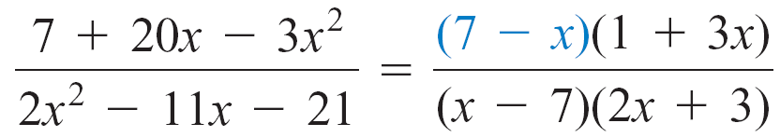
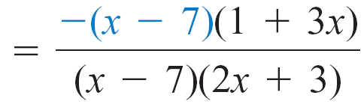
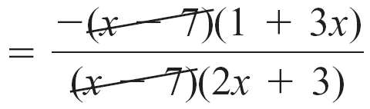
SIMPLIFYING RATIONAL EXPRESSIONS
EXAMPLE
Simplify:
Solution:
Factor.
Use (7 – x) = –(x – 7).
x ≠ 7.

Slide 10
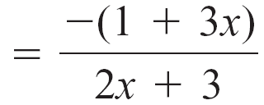
SIMPLIFYING RATIONAL EXPRESSIONS
cont’d

Slide 11
OPERATIONS ON RATIONAL EXPRESSIONS

Slide 12

OPERATIONS ON RATIONAL EXPRESSIONS
Arithmetic operations are defined on rational expressions in the same way as they are on rational numbers.
Definitions of Arithmetic Operations for Rational Expressions
For all rational expressions and where Q ≠ 0 and S ≠ 0,
Addition
Subtraction

Slide 13
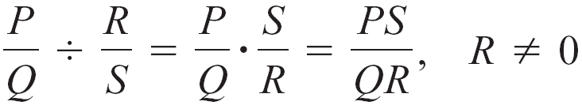
OPERATIONS ON RATIONAL EXPRESSIONS
Multiplication
Division
Factoring and the equivalent expressions property of
rational expressions are used in the multiplication and
division of rational expressions.

Slide 14
OPERATIONS ON RATIONAL EXPRESSIONS
EXAMPLE
Multiply:
Solution:
Factor.
2 – x = –(x – 2).

Slide 15
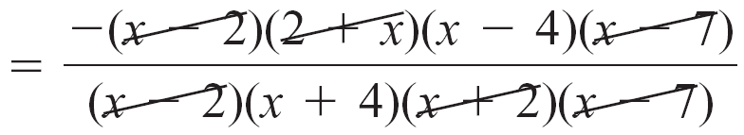
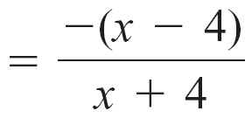
OPERATIONS ON RATIONAL EXPRESSIONS
cont’d
Simplify.

Slide 16
OPERATIONS ON RATIONAL EXPRESSIONS
Addition of rational expressions with a common
denominator is accomplished by writing the sum of the
numerators over the common denominator. For example,
If the rational expressions do not have a common denominator, then they can be written as equivalent expressions that have a common denominator by multiplying the numerator and denominator of each of the rational expressions by the required polynomials.

Slide 17
OPERATIONS ON RATIONAL EXPRESSIONS
The following procedure can be used to determine the least
common denominator (LCD) of rational expressions.
It is similar to the process used to find the LCD of rational numbers.

Slide 18
Determining the LCD of Rational Expressions

Slide 19
Determining the LCD of Rational Expressions
1. Factor each denominator completely and express repeated factors using exponential notation.
2. Identify the largest power of each factor in any single factorization. The LCD is the product of each factor raised to its largest power.
For example, the rational expressions
have an LCD of (x + 3)(2x – 1).

Slide 20
Determining the LCD of Rational Expressions
The rational expressions
have an LCD of x(x + 5)²(x – 7)³.

Slide 21
ADD AND SUBTRACT RATIONAL EXPRESSIONS
Perform the indicated operation and then simplify, if possible.
a.
b.

Slide 22
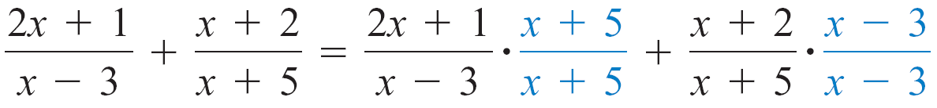
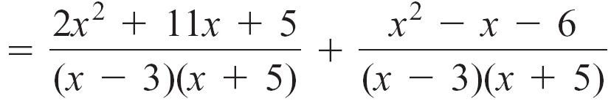
SOLUTION
The LCD is (x – 3)(x + 5). Write equivalent fractions in terms of the LCD, and then add.
Add.
Simplify.

Slide 23
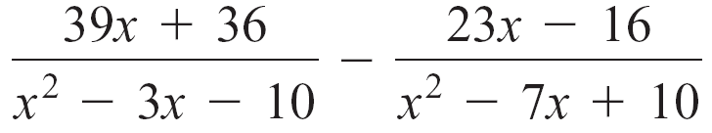
SOLUTION
cont’d
Factor the denominators:
x² – 3x – 10 = (x – 5)(x + 2)
x² – 7x + 10 = (x – 5)(x – 2)
The LCD is (x – 5)(x + 2)(x – 2). Write equivalent fractions in terms of the LCD, and then subtract.

Slide 24
cont’d

Slide 25
cont’d

Slide 26
COMPLEX FRACTIONS

Slide 27

COMPLEX FRACTIONS
A complex fraction is a fraction whose numerator or denominator contains one or more fractions. Simplify complex fractions using one of the following methods.
Methods for Simplifying Complex Fractions
Method 1: Multiply by 1 in the form .
1. Determine the LCD of all fractions in the complex fraction.
2. Multiply both the numerator and the denominator of the complex fraction by the LCD.
3. If possible, simplify the resulting rational expression.

Slide 28
COMPLEX FRACTIONS
Method 2: Multiply the numerator by the reciprocal of the denominator.
Simplify the numerator to a single fraction and the denominator to a single fraction.
Using the definition for dividing fractions, multiply the numerator by the reciprocal of the denominator.
3. If possible, simplify the resulting rational expression.

Slide 29
SIMPLIFY COMPLEX FRACTIONS
Simplify.
a. b.

Slide 30
SOLUTION
Simplify the numerator to a single fraction and the denominator to a single fraction.
Simplify the numerator and denominator.

Slide 31
SOLUTION
cont’d
Multiply the numerator by the
reciprocal of the denominator.

Slide 32
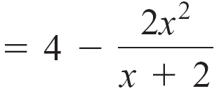
SOLUTION
cont’d
Multiply the numerator and denominator by the LCD of all the fractions.
Simplify.
Subtract. The LCD is x + 2.

Slide 33
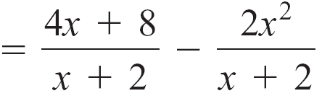
SOLUTION
cont’d

Slide 34
APPLICATION OF RATIONAL EXPRESSIONS

Slide 35
SOLVE AN APPLICATION
The average speed for a round trip is given by the complex fraction
where v₁ is the average speed on the way to your destination and v₂ is the average speed on your return trip. Find the average speed for a round trip if v₁ = 50 mph and v₂ = 40 mph.

Slide 36
SOLUTION
Evaluate the complex fraction with v₁ = 50 and v₂ = 40.
Substitute the given values for v₁ and v₂. Then simplify the denominator.

Slide 37
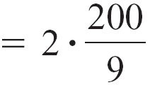
SOLUTION
cont’d
The average speed for the round trip is mph.

